Slide 1


PEDIATRIC CHEST IMAGING - A Primer
Dr. Seth J. Crapp, DABR
Founder & Medical Director, Specialty Focused Radiology
Board Certified Diagnostic Radiology CAQ Pediatric Radiology

Slide 2
Goals & Objectives:
Review basic chest radiographic anatomy
Apply a checklist methodology for chest x-ray interpretation
Review specific points and pitfalls of pediatric chest x-ray interpretation including tubes and lines and evaluation for pneumothorax, pneumomediastinum and foreign body.

Slide 3
Anatomy

Slide 5
Chest radiograph checklist:
Trachea in midline or slight buckle to right at thoracic inlet.
Thymus - large water dense mass in the superior mediastinum. Usually wavy contour. Bilobed but not always symmetrical.
Heart - water dense seen usually with apex to left. Occupies about 50% of chest width at widest point. Aortic knob may be seen through thymus on left.
Pulmonary vessels - hila seen best on lateral. Vessels extend to mid lung, tapering gradually.
Lungs - uniformly aerated. Appear black on most films.
Bony structures - ribs usually 10-12 well seen. Upper thoracic vertebral bodies, scapulae, and clavicles seen well.
Diaphragms - right and left equal. Usually seen at level of 9-10 ribs.
Source: http://www.indyrad.iupui.edu/rtf/teaching/medstudents/pedchest.htm

Slide 6
Chest Tubes and Catheters.

Slide 7
An essential part of the assessment of the neonatal chest x-ray includes identification of the position of the various tubes.
Endotracheal tubes (ETT).
Nasogastric tubes (NGT).
Central venous lines.
Umbilical venous catheters.
Umbilical arterial catheters.

Slide 8
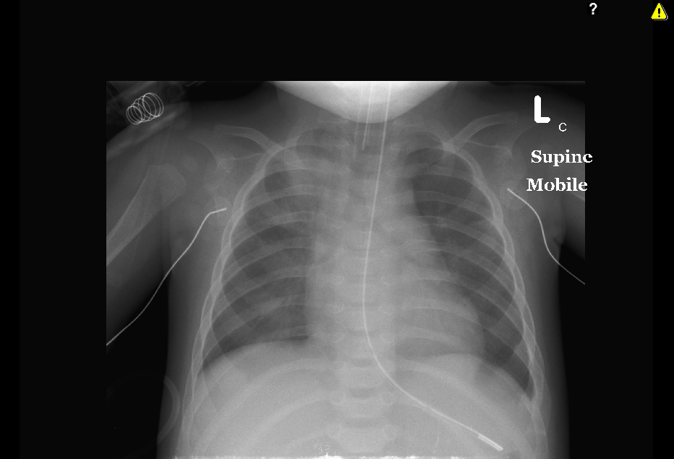

Slide 9
Is clearly recognized in the midline in the neck and upper chest as it has an opaque wall.
Ideally the tip of should lie between C7 and T4, 1.2cm below the vocal cords, or 2cm above the level of carina.
The position can change considerably with head movement, ,so when the tube is near T4 it could be displaced into the right main bronchus.

Slide 11
Is seen in the stomach, it should not be positioned at the gastroesophageal junction or above as fluid will reflux into the esophagus with a risk of aspiration.

Slide 12
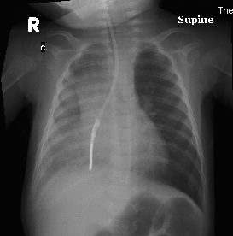

Slide 13
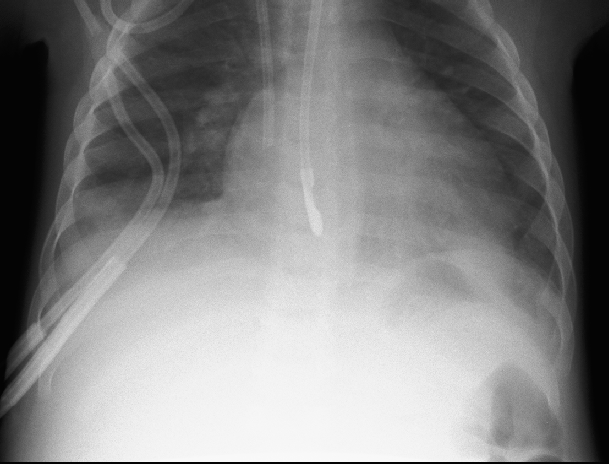

Slide 14
The central venous line is usually inserted either through:
(i) the subclavian vein to the brachiocephalic vein and then superior vena cava (SVC); or
(ii) the internal jugular vein into the brachiocephalic vein and into the SVC.

Slide 15
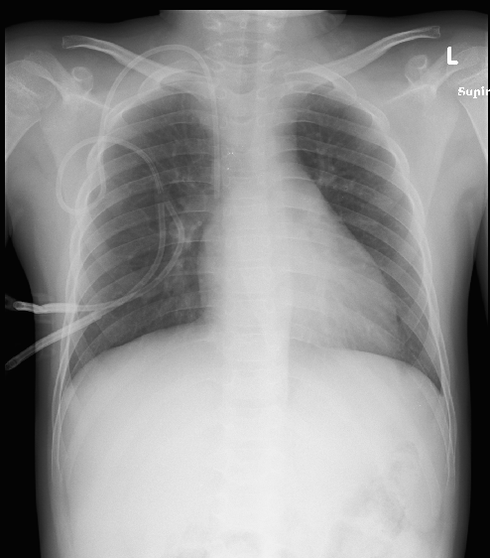

Slide 16
Umbilical Venous and Arterial Catheters

Slide 17
Text
Source: http://www.chw.org/display/PPF/DocID/23347/router.asp

Slide 18
The umbilical artery is a direct continuation of the internal iliac arteries,
thus; the catheter is recognized by the characteristic loop formed by its entry position into the umbilicus from it loops down into the pelvis to join to the internal iliac artery before passing into the common iliac artery and aorta.

Slide 19
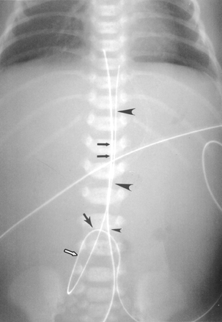
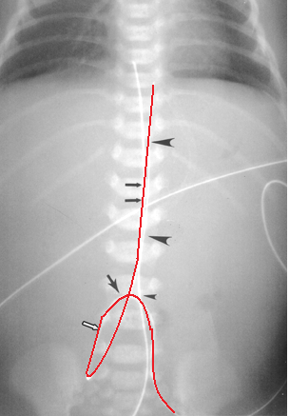

Slide 20
Two potential positions:
*High: T4/6—T9/10 ( above the diaphragm), preferred position
*Low: L3-L4 (above the aortic bifurcation/L4-L5)

Slide 21
Too low a position should also be avoided to prevent complications of bowel or renal ischemia, which may occur if the catheter is between T12 and L2.
The spinal arteries are at the level of L1-L4.
The superior mesenteric artery T12-L2.
The renal arteries at L1.

Slide 22
The UVC passes straight from the umbilicus through the intrahepatic portion of the umbilical vein, through the ductus venosus into the IVC and thus to the right atrium.
Ideally the tip should be maintained at the IVC/RA junction at T8-T9, but this position is hard to be achieved.

Slide 23
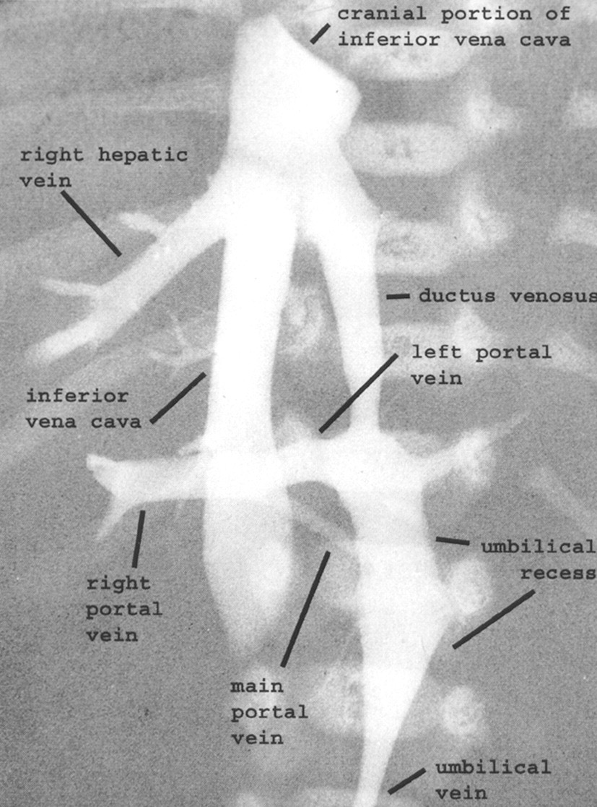

—Postmortem venogram in 27-week premature neonate shows normal anatomy.
Schlesinger A E et al. AJR 2003;180:1147-1153
©2003 by American Roentgen Ray Society
Notes:
—Postmortem venogram in 27-week premature neonate shows normal anatomy. Umbilical vein enters left portal vein opposite origin of ductus venosus. Focal dilatation of umbilical vein just inferior to its insertion into left portal vein is umbilical recess. Ductus venosus begins at left portal vein opposite site of insertion of umbilical vein and courses to inferior vena cava, entering inferior vena cava at or near confluence of inferior vena cava and hepatic veins. (Adapted with permission from [1])‏

Slide 24
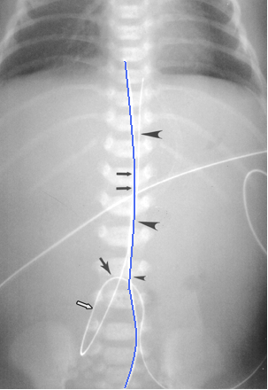

Slide 25
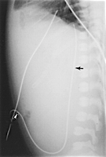

Slide 26
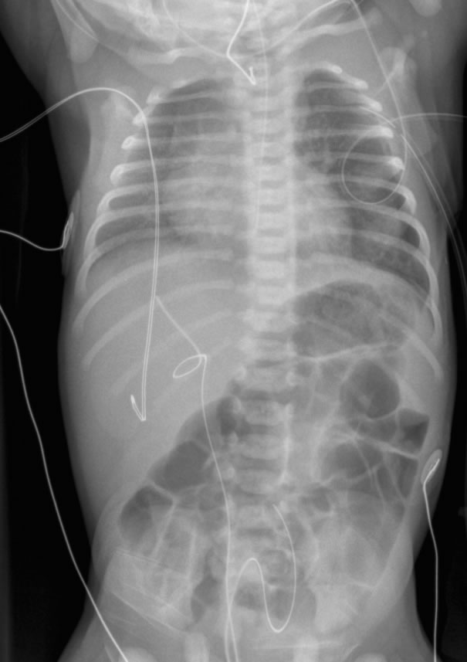

Slide 27
Another important feature to recognize in the pediatric chest is the normal thymic tissue in the anterior mediastinum. Normal thymic tissue, should not be confused with a mediastinal or pulmonary mass.
Thymus gland

Slide 28
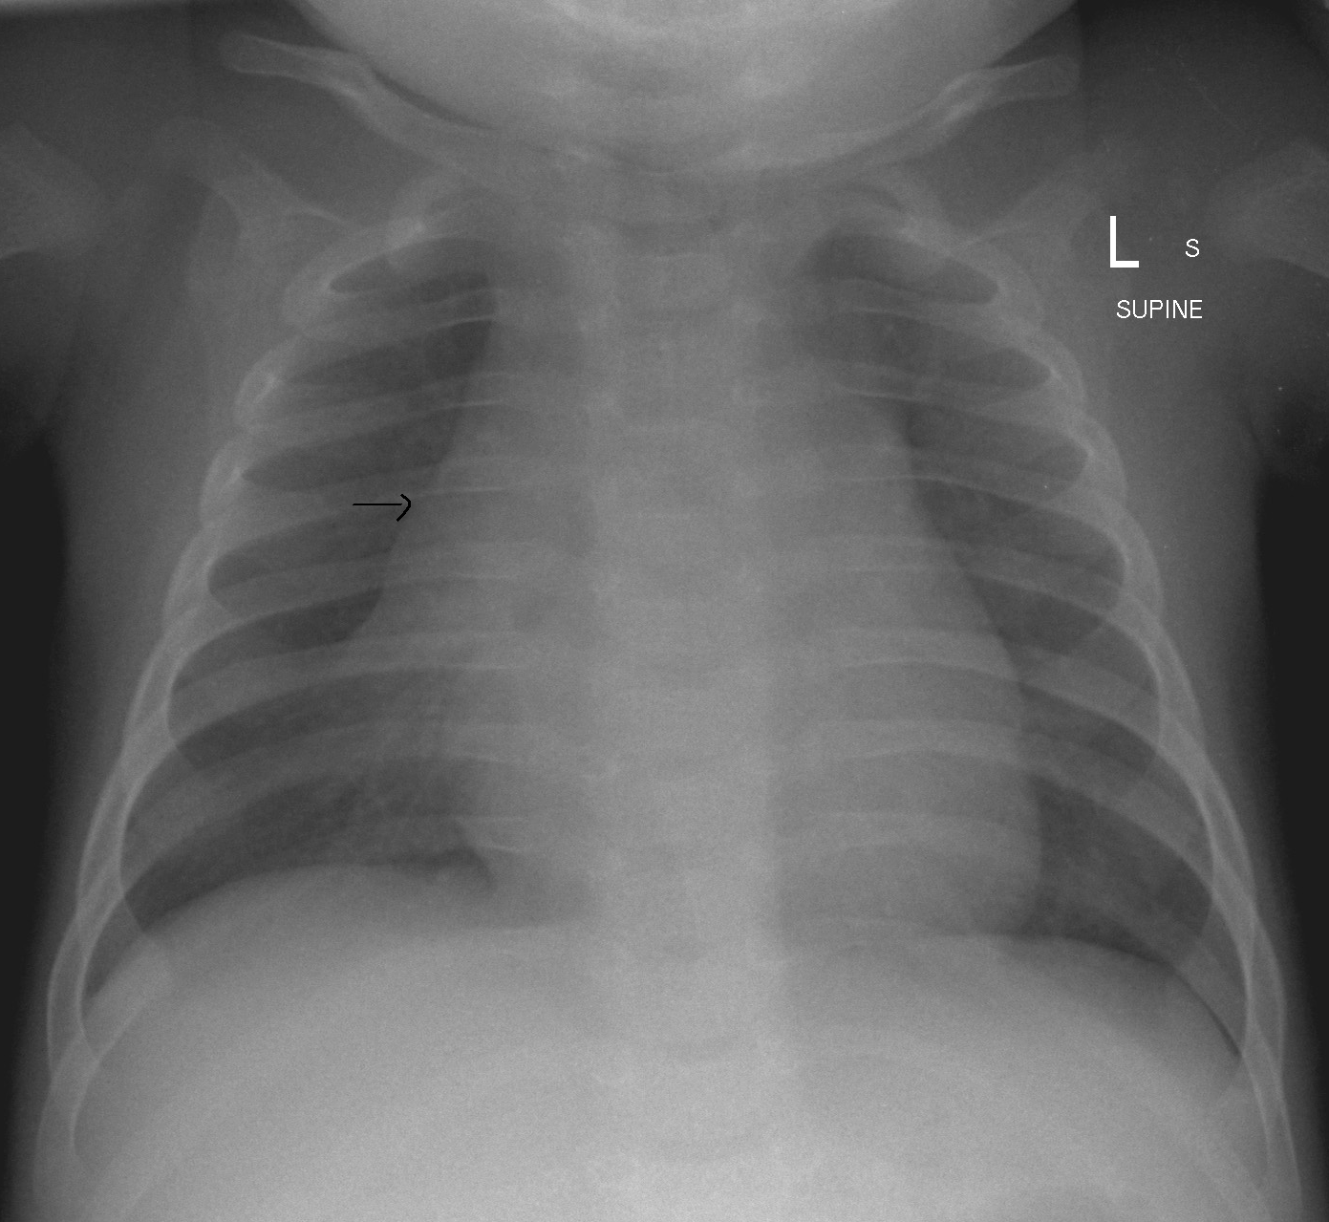

Slide 29
The thymus is normally prominent on chest films during the first few years of life.
Less noticeable after 3-4years of ages.
It is clearly visible to the right or left or on both sides of the mediastinum
The usual limits in young children are from the level of the left brachiocephalic vein to the level of the pulmonary arteries inferiorly. It may, however, extend into the neck and down to the level of the diaphragm in young infants.

Slide 30
In the right chest it often has a typical sail shape with a horizontal lower border and an outer border paralleling the chest wall. It frequently abuts anterior ribs leading to an undulating appearance.

Slide 31
The normal thymus is not typically very radio-opaque but it usually permits visualization of pulmonary vessels through it, it does not compress the airway or adjacent vasculature. In most neonates, temporary thymic involution is seen during episodes of acute illness.
Thymic rebound or regrowth is often seen after recovery from a severe illness or after chemotherapy.

Slide 32
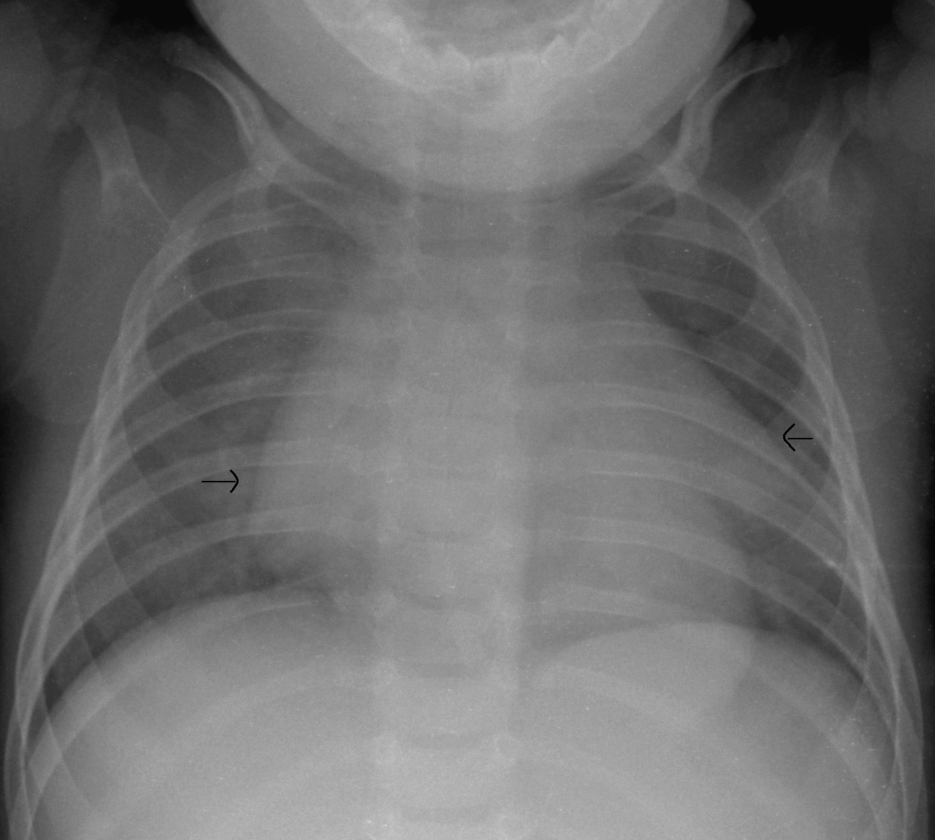
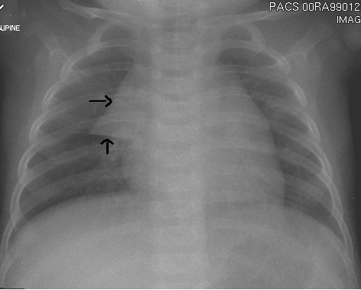

Slide 33
Pneumothorax, Pneumomediastinum, Pneumopericardium

Slide 34
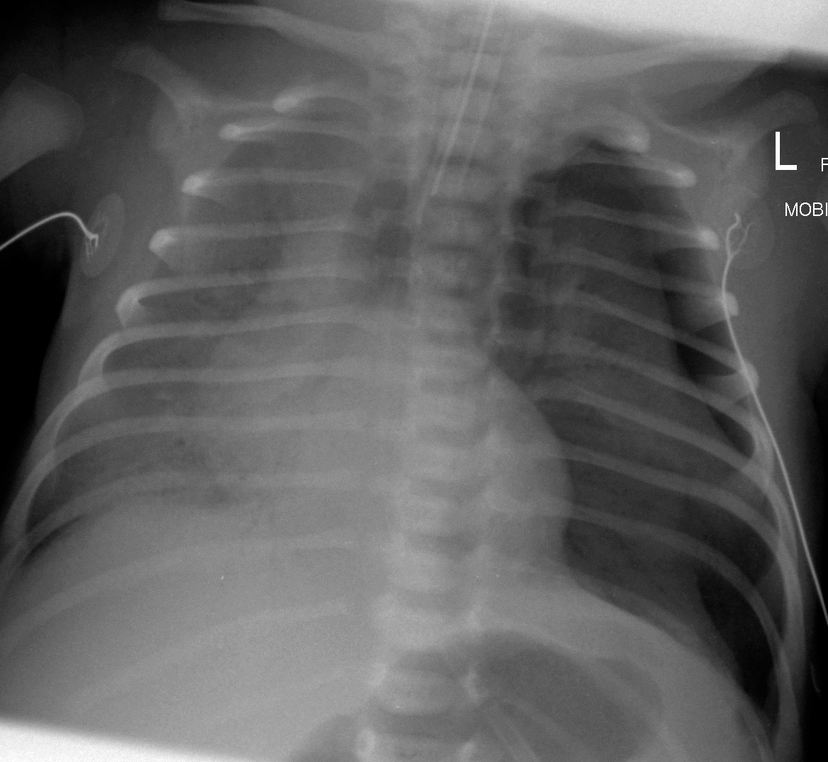

Slide 35
The presence of free air either in the chest or abdomen is a frequent complication of disease and therapy in the neonatal setting.
All exams should be thoroughly scrutinized for the presence of pneumothorax, pneumomediastinum, or pneumoperitoneum.
A decubitis CXR, with the side of interest upright, should be obtained to evaluate for a pneumothorax.
If the child cannot be positioned for the decubitis exam then a cross table lateral chest XR.

Slide 36
Pneumothorax occurs spontaneously in a few newborn infants, more commonly occurs as a complication of ventilator therapy in hyaline membrane disease.
Classically a pneumothorax appears as an area of radiolucency between the edge of the lung and the chest wall and absence of lung markings peripherally.

Slide 37
In neonates the signs are more subtle, the side of the chest with the pneumothorax is more radiolucent than the normal side, the edge of the mediastinum and sometimes the diaphragm may be more sharply defined than normal, this is the so called etched heart border sign, and is due to interposition of air in the pleural cavity between the heart and lung giving a clear outline.
The air sometimes causes elevation of the thymus gland from the mediastinum giving the appearance of angel wings. The hyperlucent costophrenic angle is known as the deep sulcus sign.

Slide 38
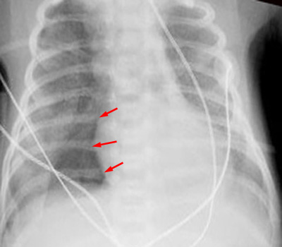
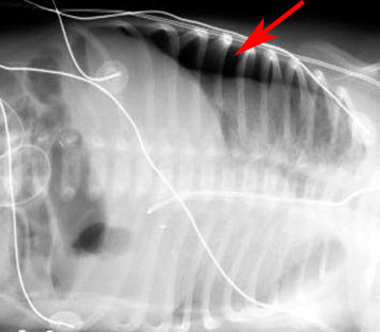

Slide 39
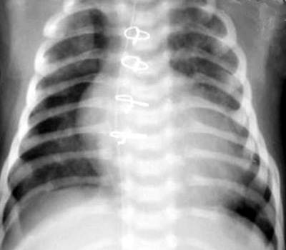

Slide 40
Air in the mediastinum is an occasional complication of a pneumothorax. And appears as a band of decrease attenuation against the heart. It can extend over the diaphragm between the two layers of pleura and can extend up into the neck.
Air in the pericardium has a similar appearance but is restricted by the reflections of the pericardium rather than the whole mediastinum outline.

Slide 41
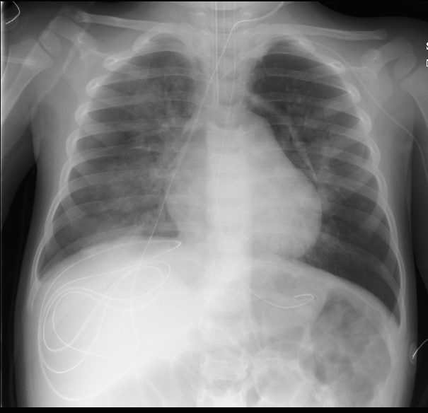

Slide 42
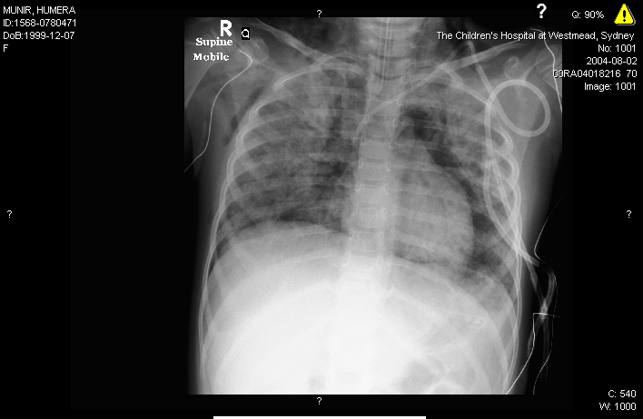

Slide 43
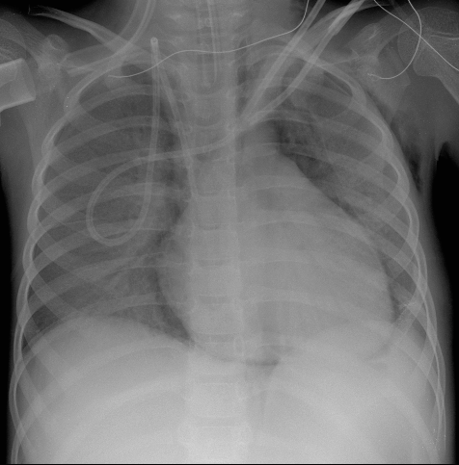

Slide 44
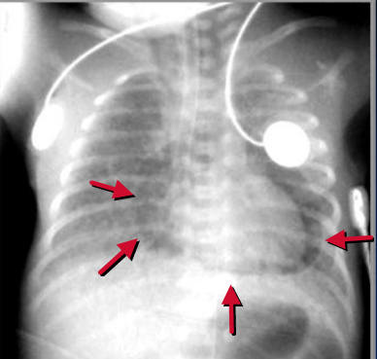

Slide 45
Foreign Body Inhalation

Slide 46
Only large inhaled foreign bodies lodge in the trachea, smaller objects lodge in the bronchial tree and affect the lower lobes or on the right, the middle lobe.
Very small foreign bodies, may migrate to the peripheral bronchi, penetrate them and cause the formation of a granuloma around them. Inorganic foreign bodies are usually inert and their effects are due to mechanical obstruction of the airway and to direct injury to the bronchial wall. Organic matter, not only causes mechanical problems but also local inflammation, which may cause stenosis.
85% of foreign bodies are non-opaque.

Slide 47
Radiographic investigation include paired inspiratory and expiratory films or, if easier, brief fluoroscopy.
Decubitus films are an alternative mainly in young children, where both sides are taken. The lung with air trapping will not compress in the dependent position.
One lung or lobe may be hyperlucent or hyperinflated, with air trapping on expiration, known as obstructive emphysema, due to a ball valve obstruction, allowing entry of air during inspiration, but not allowing escape in expiration.
Complete bronchial obstruction can cause distal atelectasis.

Slide 48
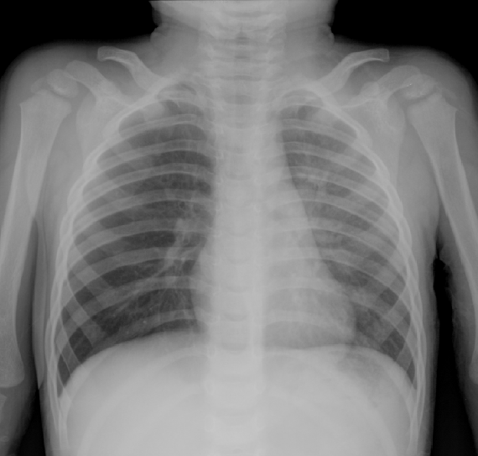

Slide 49
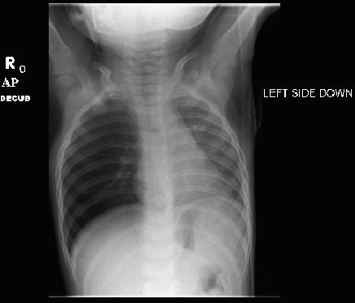
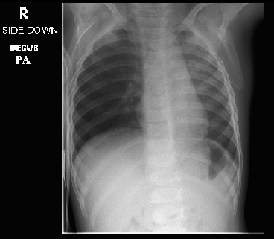

Slide 50
Chest radiograph checklist:
Trachea in midline or slight buckle to right at thoracic inlet.
Thymus - large water dense mass in the superior mediastinum. Usually wavy contour. Bilobed but not always symmetrical.
Heart - water dense seen usually with apex to left. Occupies about 50% of chest width at widest point. Aortic knob may be seen through thymus on left.
Pulmonary vessels - hila seen best on lateral. Vessels extend to mid lung, tapering gradually.
Lungs - uniformly aerated. Appear black on most films.
Bony structures - ribs usually 10-12 well seen. Upper thoracic vertebral bodies, scapulae, and clavicles seen well.
Diaphragms - right and left equal. Usually seen at level of 9-10 ribs.
Source: http://www.indyrad.iupui.edu/rtf/teaching/medstudents/pedchest.htm

Slide 51
THANK YOU!
Dr. Seth J. Crapp, DABR
Board Certified Diagnostic Radiology CAQ Pediatric Radiology
www.sflrad.com or 844-473-4-SFLRAD

